Slide 1



TOPIC: Digital Payment Awareness
COURSE: CCC Concepts
Day: 41
Presented By: Shruti Dubey

Slide 2
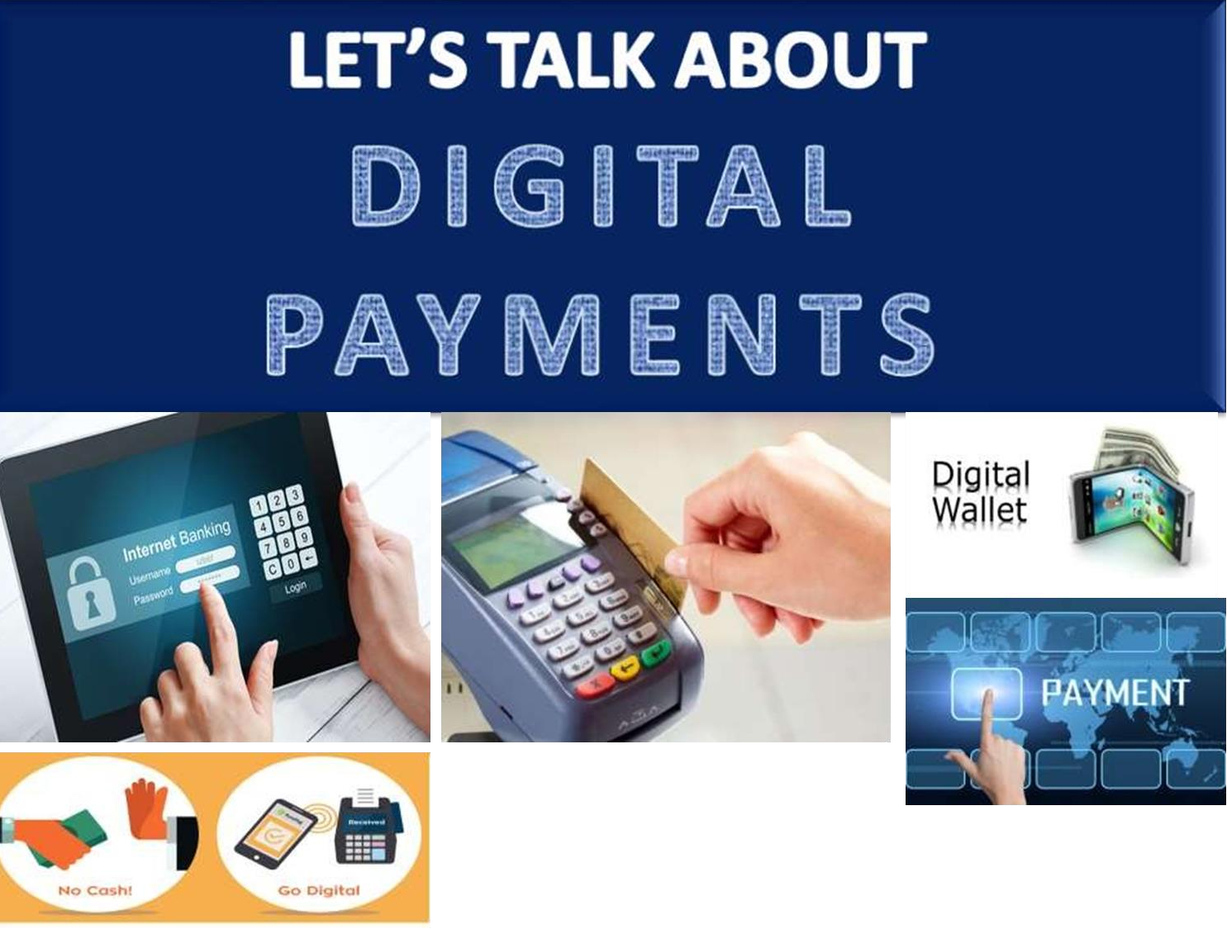

Slide 3
Major Digital Financial Service
Banking Cards
PoS Transactions
Internet Banking
Mobile Banking
UPI (Unified Payment Interface)
Bharat Interface for Money (BHIM)
e-Wallet

Slide 4
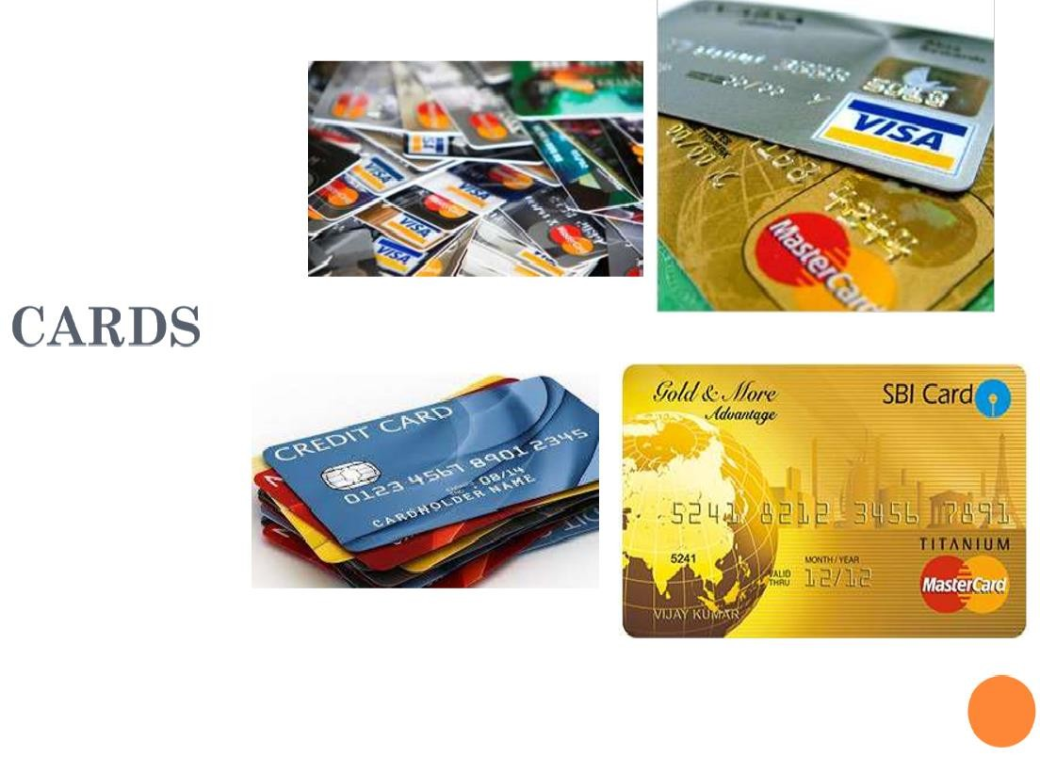
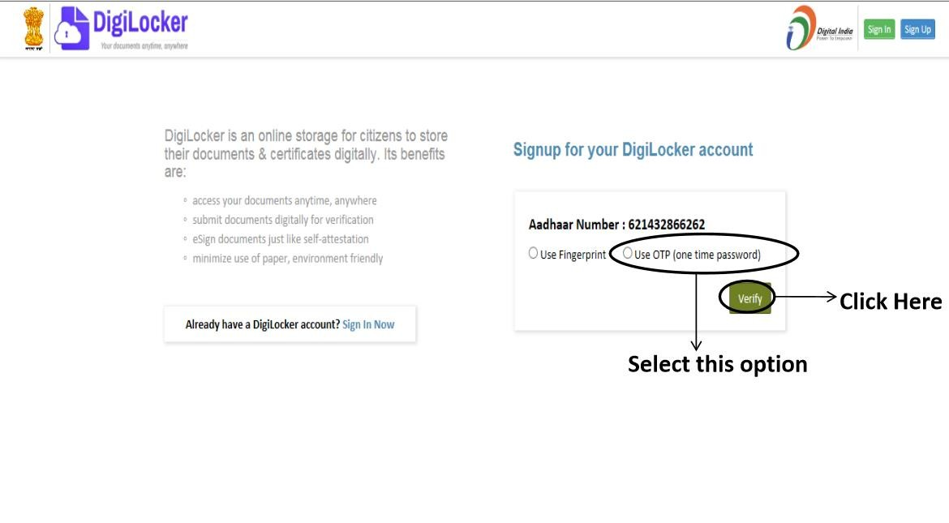
Digilocker
https://digilocker.gov.in/

Slide 5
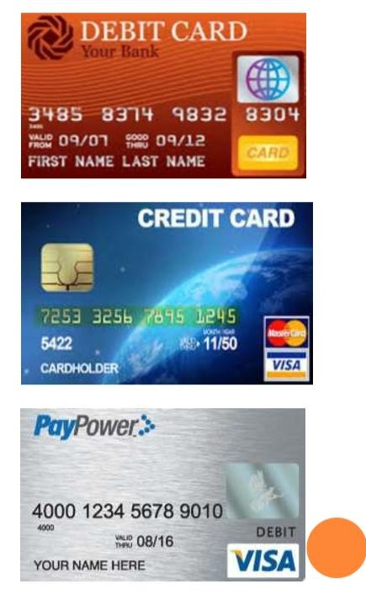
What are Cards?
These are usually issued by banks and can be classified on the basis of their issuance, usage and payment by the card holder
There are three types of cards:
Debit cards
Credit cards
Prepaid cards

Slide 6
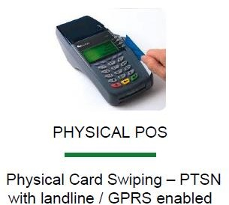
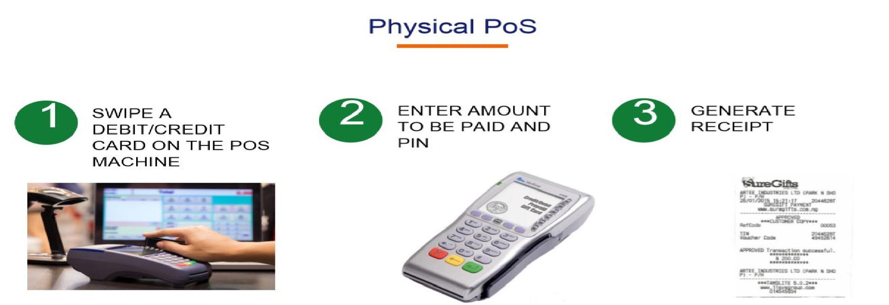
PoS (Point of Sale)
A point of sale terminal (POS terminal) is an electronic device used to process card payments at retail locations through debit cards, credit cards and mobile payments

Slide 7
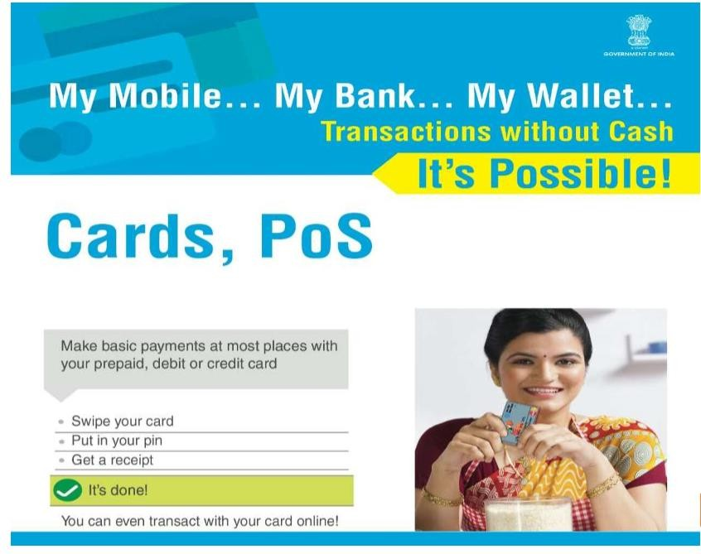
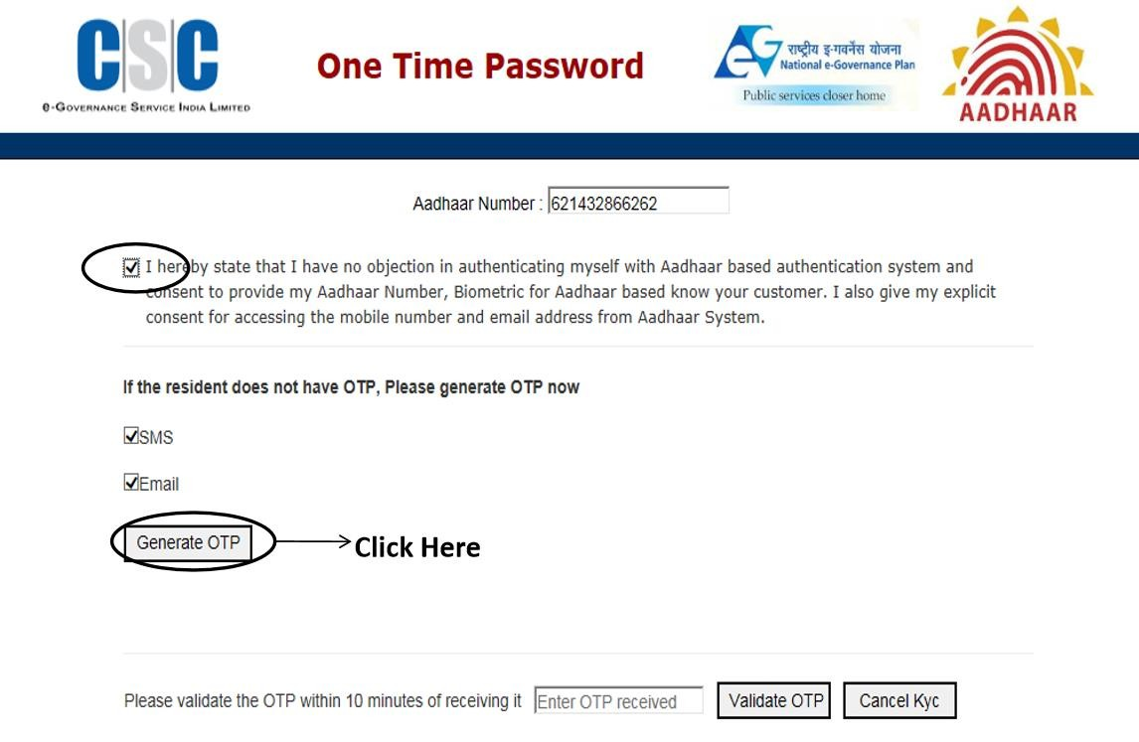
Digilocker
https://digilocker.gov.in/

Slide 8
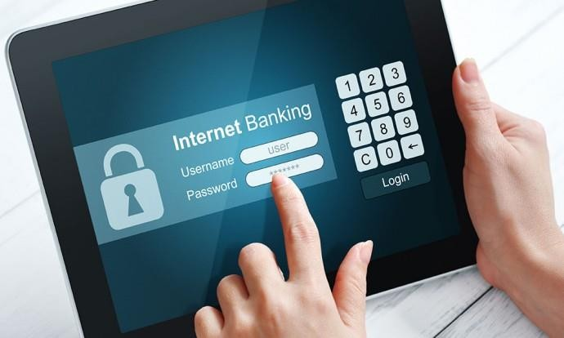
Internet Banking
Internet Banking means any user with a personal computer and a browser can get connected to his bank’s website and perform banking functions virtually

Slide 9
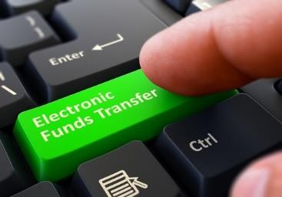
Internet Banking
It is one of the oldest methods to transfer money
It is the groundwork of cheque-less culture, it is used to transfer money without any paper currency

Slide 10
Benefits of Internet Banking
Simplified accounting
Improved efficiency
Reduced administrative costs
Improved security

Slide 11
Thank you!
www.nielit.gov.in/haridwar

